Slide 1





PostHaven Farm G2
E v a l u a t i o n
R e p o r t
B u l l E v a l u a t i o n
Evaluation Date:
16-Feb-2026
Group Information
Centre Manager:
E. JOHN POST
Farm Name:
POSTHAVEN FARM
Contact Information:
519-846-9320 /
ejpost@posthavenlimousin.c om
Test Information
Period #
Date
Delivery
SOT
28d 56d
84d EOT
8
8
8
0
0
0
12-Dec-25
09-Jan-26
06-Feb-26
Top BIO$
Top Maternal POSTHAVEN NEXUS
Top Terminal POSTHAVEN NICHOLAS
Top Balanced POSTHAVEN NICHOLAS
Centre Manager Comments
Provision and Use of Information Produced by AgSights. As part of the terms and conditions of AgSights’ Beef Evaluation Services, it is understood that information provided by AgSights including, but not limited to, genetic and carcass evaluations, are calculated with generally accepted animal breeding methodologies using raw data and pedigreed provided by the breeder and/or owner of the animal. The accuracy of input data has a direct impact on the results received. The client requesting AgSights’ Beef Evaluation Services is wholly responsible for verifying the accuracy of data.
The intention of the information provided by AgSights is for comparative purposes only to provide general guidance to breeders and buyers. The user of this information agrees to hold AgSights harmless for any losses or damages that may be incurred as a result of receipt and/or reliance upon this comparative information. This clause shall be a complete defense to any claim brought by the purchaser and/or user in relation to such services.

Slide 2

PostHaven Farm G2
E v a l u a t i o n G u i d e - 1
B u l l E v a l u a t i o n
Evaluation Date: 16-Feb-2026
Thank you for participating in an AgSights Beef Evaluation Program! Included in this evaluation report are Group Reports and individual Performance Sheets for each animal.
Group Reports Performance Sheets
Summarizes performance data across the whole group and within each breed. Remember that performance data should only be compared within contemporaries (animals managed the same, with the same opportunity to perform).
Performance sheets provide detailed performance and genetic evaluation data for an individual animal. Information that is not available or applicable, is indicated by “NA”.
Breed – The green box at the top of the report indicates what breed is summarized, or All for the group summary.
Growth Curve Graph – Average growth of the group from
Birth to EOT. The average growth of the group (green) is shown relative to expected (grey) 3 lb/day growth. The shaded area is the range of weights at a given period.
Average Test Performance – Number of animals, weigh date, and group averages for weight traits (weight, ADG, WPDA) for each test period from Delivery to EOT.
Average Growth – Average performance (raw or adjusted – Adj) for various growth traits. The graphs show individual performance as a deviation from the group average.
Genetic Merit – Rankings for animals on a 1 to 5 star scale graphed for the Maternal, Terminal and Balanced indexes.
Superior animals will have more stars.
Average Ultrasound/Physical Evaluation – Average performance (raw or adjusted - Adj) for ultrasound and EOT traits. The graphs for Rib Eye Area and Scrotal Circumference (SC) are a deviation from group average, while the Grade shows the expected carcass grade of the animal based on marbling.
Centre Manager Comments and Contact Information
Basic Information – Basic identification and birth information for the animal.
Overall Genetic Merit – Index values for the four
available indexes (BIO$, Maternal, Terminal and Balanced). These indexes can be compared across all breeds, more information below.
Pedigree – Registration IDs and Names for parents and grand-parents.
Genetic Evaluations – Genetic evaluations for individual traits. This section includes a graph of percentile rankings, grey bars are the ranking within-breed (EPD), and green bars the ranking across breeds (ABC). Superior animals for a trait will rank above 50%, within or across breeds.. The numeric value for the EPD and ABC are also included, as well as the accuracy (ACC).
Performance – Raw or adjusted performance (Adj) for weight traits (left), ultrasound (centre), and physical evaluation (right).
Consignor Comments and Contact – Notes on the animal’s attributes from the consignor and contact information for prospective buyers.
•
•
•
•
•
•
•
Performance Traits
Calving Ease (CE) – The ease with which the animal was born. The categories are Unassisted, Easy Pull, Hard Pull, Surgical and Malpresentation.
Birth Weight (BWT) – Birth Weight of the animal (lb).
Weaning Weight (WWT) – The raw weaning weight of the animal, should not be used for comparisons, as it does not account for differences in age.
Adjusted Weaning Weight (Adj WWT) – The on-farm weaning weight of the animal adjusted to 200 days. Adjustments are made for age of dam and sex.
Start of Test (SOT) – Weight (lb) at Start of Test.
End of Test (EOT) – Weight (lb) at End of Test.
Adjusted Yearling Weight (Adj YWT) – The on-farm or test evaluation weight of the animals adjusted to 365 days.
Average Daily Gain (ADG) – The gain per day between two periods (e.g., Birth and Weaning, SOT and EOT).
Weight Per Day of Age (WPDA) – The weight (lb) of an animal at a given period divided by days of age, includes BWT.
Back Fat (FAT) – Measured ultrasonically (mm) between the 12th and 13th ribs (grading site) at EOT.
Rib Eye Area (REA) – Measured ultrasonically (sq in) between the 12th and 13th ribs (grading site) at EOT.
Adjusted REA (Adj REA) – REA measured at EOT and adjusted with a breed-specific adjustment factor to 365d of age.
Marbling (IMF) – Intramuscular fat measured ultrasonically (%) between the 12th and 13th ribs (grading site) at EOT.
Adj Marbling (Adj IMF) – Intramuscular fat measured ultrasonically (%) between the 12th and 13th ribs (grading site) at EOT and adjusted to 365d of age.
Grade – IMF expressed as a marbling grade (A, AA, AAA). PD indicated Practically Devoid, which is a IMF less than 1.86%. Animals near the border of a category are shown as a combination of the categories (e.g., A-AA).
Hip Height (HH) – The height of the animal at the hip bones at EOT.
Frame Score (FS) – A 1 to 10 scale calculated using HH and age, according to Beef Improvement Federation guidelines.
Scrotal Circumference (SC) – Scrotal circumference (cm) at EOT. Indication of semen production of the bull, guidelines for minimum SC are breed-specific. ABN indicated abnormal testicles and no measurements taken.
Adjusted Scrotal Circumference (Adj SC) – SC adjusted to 365d of age.
Breeding Soundness Exam – Pass/Fail Results of a Breeding Soundness Exam performed by a license veterinarian, if performed.

Slide 3

PostHaven Farm G2
E v a l u a t i o n G u i d e - 2
B u l l E v a l u a t i o n
Evaluation Date: 16-Feb-2026
The goal of this reference is to help you use the Beef Performance Evaluation Reports to inform buying and selling decisions. Genetic evaluations are the best tools we have to understand the expected value of an animal to our breeding program. Parents pass on their genetics to progeny in future calf crops, not their own raw performance, which is influenced by management (e.g., feed, age at measurement) and environment.
Understanding Genetic Evaluations
A genetic evaluation represents the expected genetic superiority of progeny, in trait units, relative to the average of animals for that trait, after adjusting for factors like management. With the exception of Birth Weight and Back Fat, larger values represent superior animals for a given trait.
EPD vs ABC
Expected Progeny Differences (EPD) compare the genetic merit of individuals within a specific breed, while Across Breed Comparisons (ABC) can be used to compare animals across all breeds.
Percentile Rankings
To simplify comparisons, percentile rankings, rank the animal on a scale of 1 (best) to 100 (worst), with the value representing animals in the Top X% within-breed (EPD, grey bars) or across-breeds (ABC, green bars). In the report graph, look for animals with bars on the right-side of graph (Top 50%) to improve a given trait.
Accuracy
The accuracy of an EPD / ABC is influenced by the amount of
POSTHAVEN NEXUS
has the best genetic merit for Weaning
Gain. This animal is in the Top within-breed (EPD) and Top across breeds (ABC).
28
67
%
%
information available. An animal with its own performance record will
Calves from this animal are expected to wean 38.3 lb more than average.
have a higher accuracy than those without. EPDs / ABCs account for the performance information on all relatives (e.g., parents, half-siblings). The higher the accuracy the more confidence you can have in your decisions.
Selection Indexes
Selection indexes simplify your
selection decisions. They combine
BIO$
The original proprietary index designed by AgSights to select bulls for commercial calf
Production Indexes
The other indexes help you to select animals for a specific purpose (e.g., maternal sires to generate replacement heifers, terminal sires for steer production).
They are reported on a 5 star scale, with 2.5 star animals being below average and 5 star animals being in the Top 10% across all breeds.
Inferior Average Superior
genetic merit for several traits important to a given production purpose into one value.
production.
The traits are weighted to account for their importance to revenue/cost on an average operation. Index values can be used to compare animals across breeds.
In the report, index values are colour
The value indicates additional profit, in dollars, expected to be generated from the use of a
bull across two calving
to an
seasons, compared average bull.
Top 3 Bulls for BIO$:
1.
2.
3.
coded: green (BIO$), light grey
99
50
1
(Maternal), medium grey (Terminal), dark
grey (Balanced), so you can quickly reference which traits are used in each.
Evaluated Traits
Calving Ease (CE) – Genetic prediction of the increase or decrease in percentage unassisted calvings.
Birth Weight (BW) – The expected effect (lb) an animal will have on the average BWT of their calves.
Weaning Gain (WG) – The expected effect (lb) an animal will have on their calves’ ability to grow form birth to weaning
Maternal Calving Ease (CEm) – The expected effect of the animal’s daughters on the calving ease (% unassisted) of the calves.
Maternal Birth Weight (BWm) – The expected effect of the animal’s daughters on the birth weight (lb) of the calf.
Mothering Ability (MILK) – The ability of the animal’s daughters to provide their calves with milk / mothering to influence pre-wean growth (lb).
Post-Weaning Gain (PWG) – Indicates the ability of the animal’s calves to grow from weaning to yearling (lb).
Yearling Gain (YG) – Indicates the ability of the animal’s calves to grow from birth to yearling (lb).
Back Fat (FAT) – The ability of an animal’s progeny to deposit back fat (mm), or finishing ability, adjusted to a common age.
Rib Eye Area (REA) – Predictor of the difference in rib eye area (sq in), or muscling, of an animal’s progeny.
Marbling (IMF) – The ability of an animal’s progeny to deposit marbling fat (%), adjusted to a common age.
Scrotal Circumference (SC) – The ability of a bull to transmit scrotal size to male progeny. It is a partial indicator of daughter fertility.

Slide 4
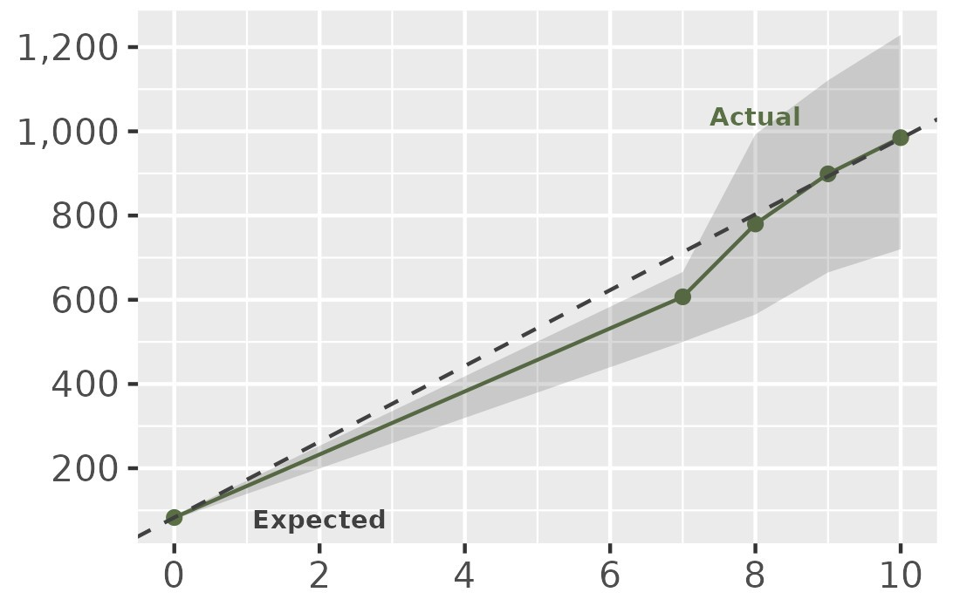
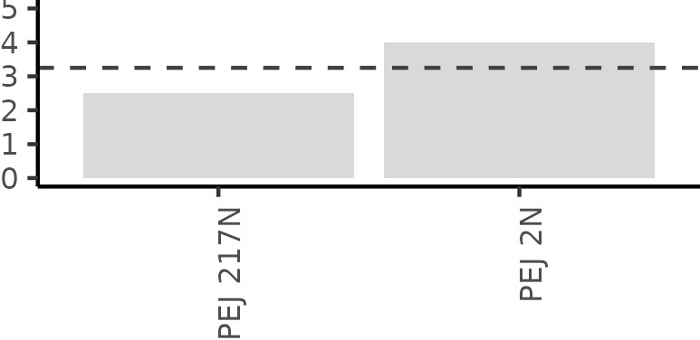
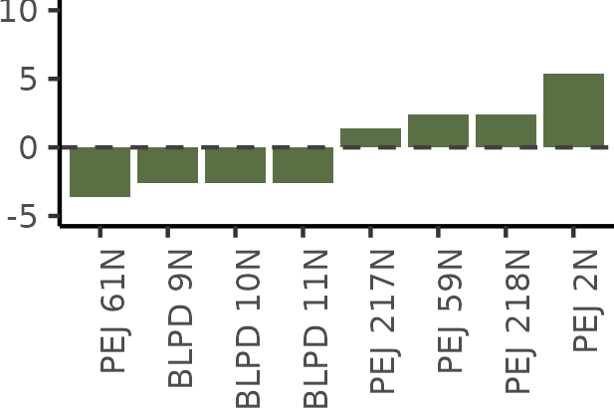
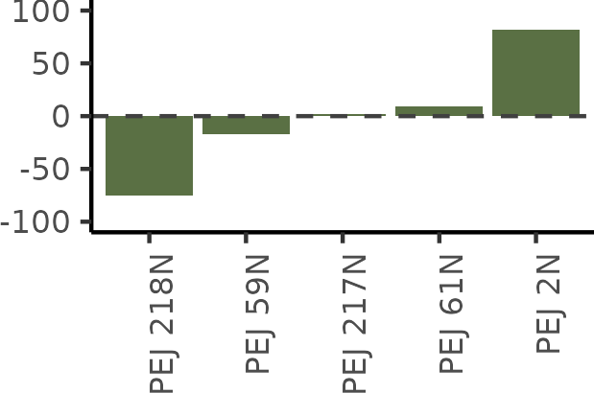
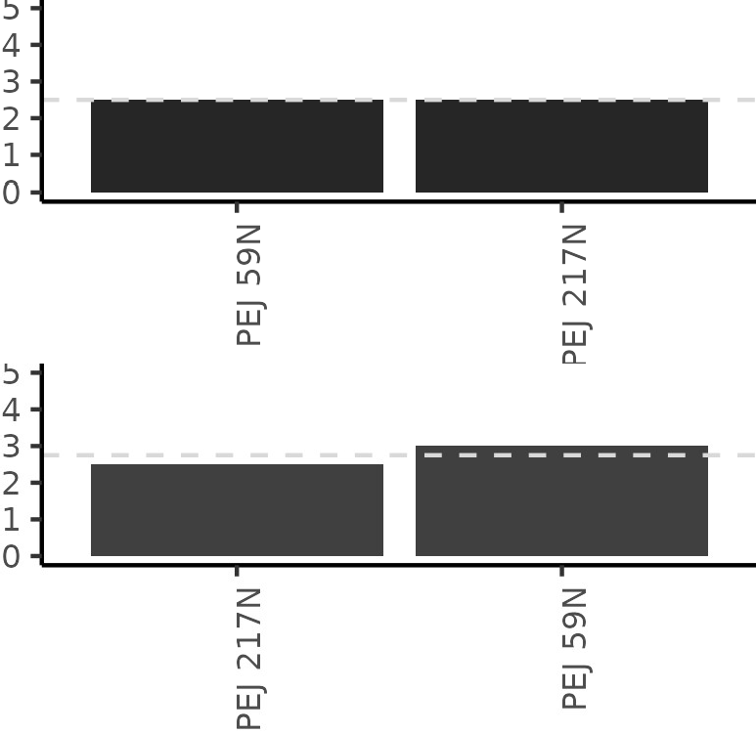
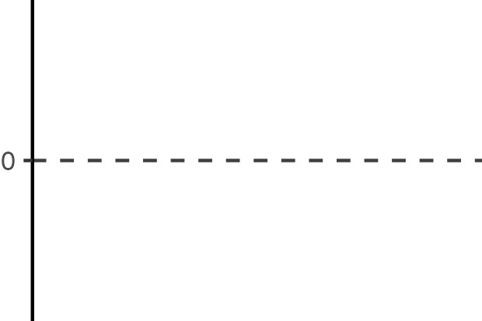
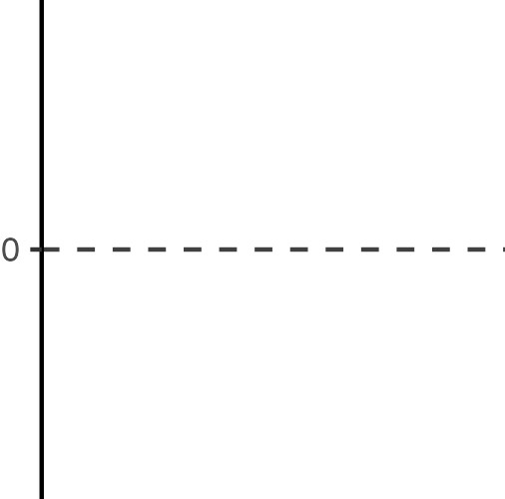
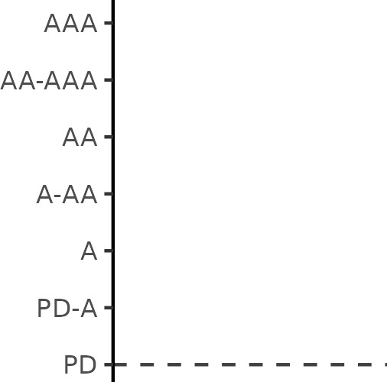
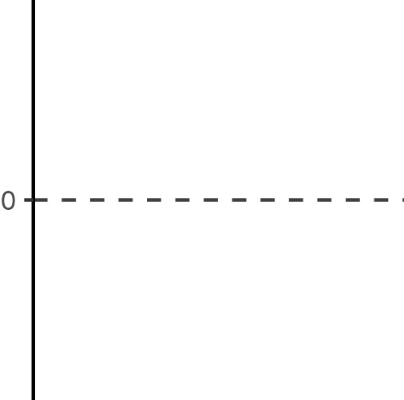
PostHaven Farm G2
28D
R e p o r t
B u l l E v a l u a t i o n
All Breeds
A V E R A G E T E S T
16-Feb-2026
Last Updated
P E R F O R M A N C E
Period | # | Date | Weight | ADG | WPDA
 |  |  | (lb) | (lb) | (lb)
Delivery | 8 | 12-Dec-25 | 780
SOT | 8 | 09-Jan-26 | 899
28d | 8 | 06-Feb-26 | 985 | 3.05 | 3.22
56d | 0
84d | 0
EOT | 0
G r o w t h ( l b ) b y M o n t h s
A V E R A G E G R O W T H
o f A g e
% Unassisted 100 | Birth 83 | Weaning 607 | Adj WWT 614 | Adj YWT
Maternal | G E N E T I C M E R I T
Terminal
Balanced
Birth (lb)
Adj WWT (lb)
EOT (lb)
Adj YWT (lb)
A V E R A G E U L T R A S O U N D / P H Y S I C A L E V A L U A T I O N
Back Fat (mm)
Rib Eye Area (in²)
Adj Rib Eye Area (in²)
Marbling (%) Adj Marbling (%) Hip Height (in)
Frame Actual SC (cm) Adj 365d SC (cm)
Adj Rib Eye Area (in²)
Grade
Adj 365d SC (cm)

Slide 5
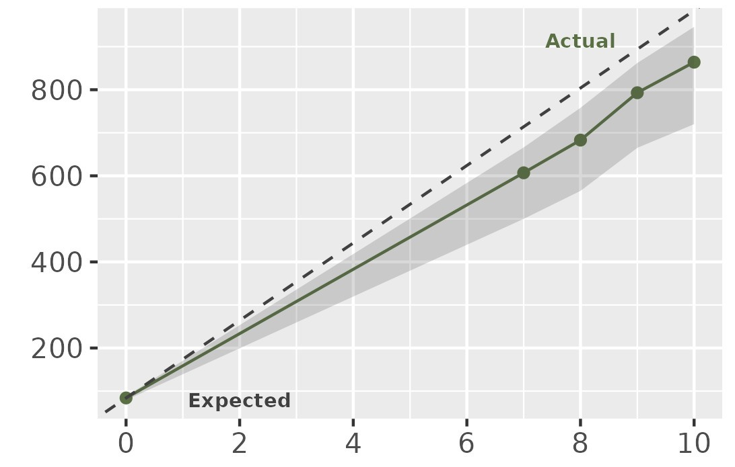
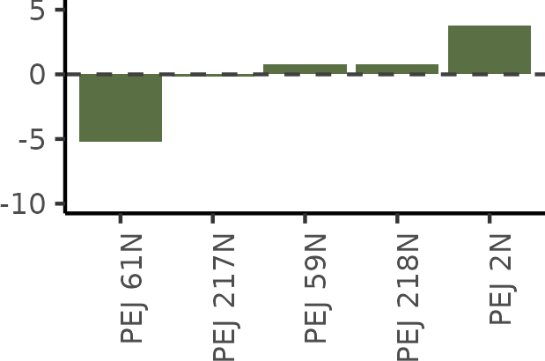
PostHaven Farm G2
28D
R e p o r t
B u l l E v a l u a t i o n
Limousin
A V E R A G E T E S T
16-Feb-2026
Last Updated
P E R F O R M A N C E
Period | # | Date | Weight | ADG | WPDA
 |  |  | (lb) | (lb) | (lb)
Delivery | 5 | 12-Dec-25 | 683
SOT | 5 | 09-Jan-26 | 793
28d | 5 | 06-Feb-26 | 864 | 2.56 | 3.11
56d | 0
84d | 0
EOT | 0
G r o w t h ( l b ) b y M o n t h s
A V E R A G E G R O W T H
o f A g e
% Unassisted 100 | Birth 84 | Weaning 607 | Adj WWT 614 | Adj YWT
Maternal | G E N E T I C M E R I T
Terminal
Balanced
Birth (lb)
Adj WWT (lb)
EOT (lb)
Adj YWT (lb)
A V E R A G E U L T R A S O U N D / P H Y S I C A L E V A L U A T I O N
Back Fat (mm)
Rib Eye Area (in²)
Adj Rib Eye Area (in²)
Marbling (%) Adj Marbling (%) Hip Height (in)
Frame Actual SC (cm) Adj 365d SC (cm)
Adj Rib Eye Area (in²)
Grade
Adj 365d SC (cm)

Slide 6
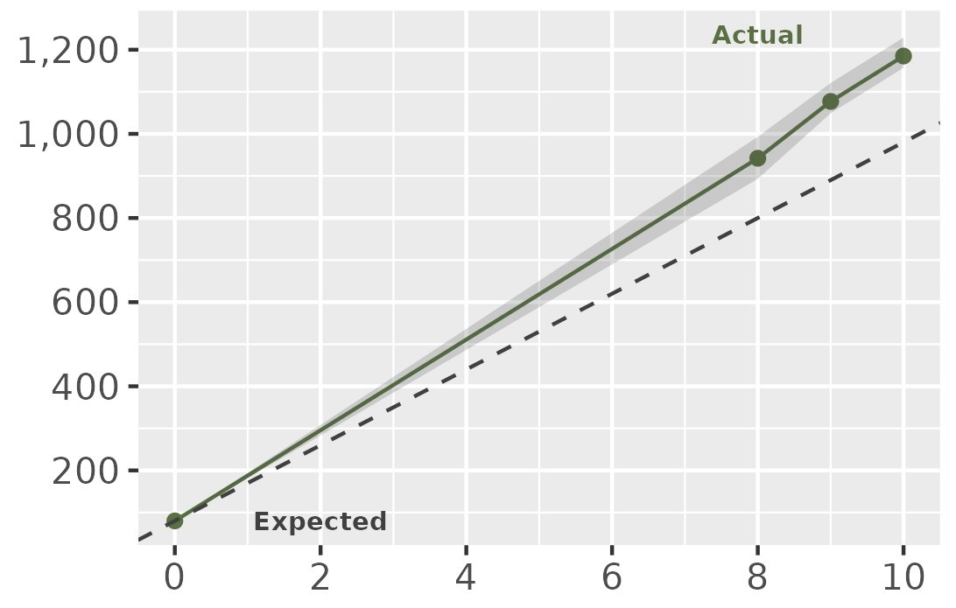
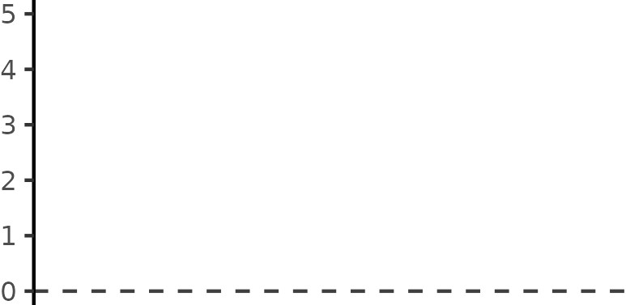
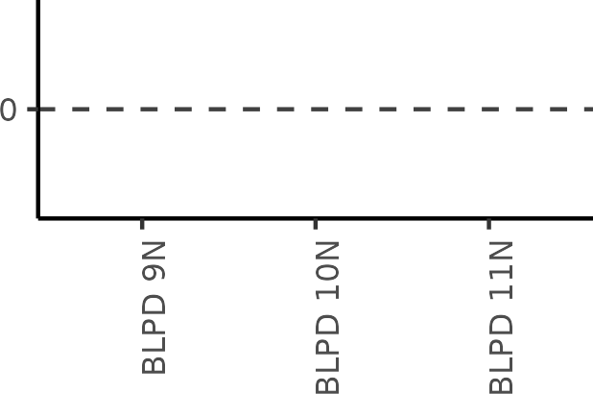
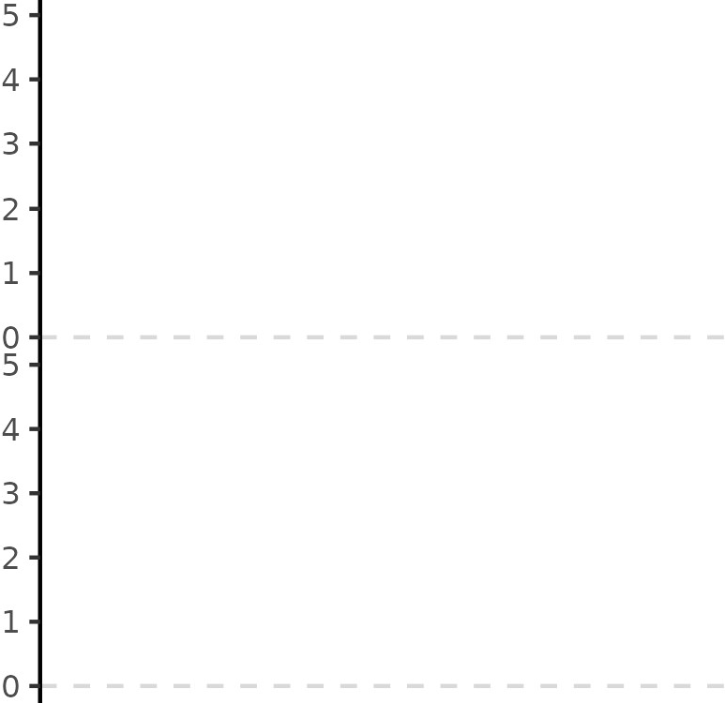
PostHaven Farm G2
28D
R e p o r t
B u l l E v a l u a t i o n
Simmental
A V E R A G E T E S T
16-Feb-2026
Last Updated
P E R F O R M A N C E
Period | # | Date | Weight | ADG | WPDA
 |  |  | (lb) | (lb) | (lb)
Delivery | 3 | 12-Dec-25 | 942
SOT | 3 | 09-Jan-26 | 1,077
28d | 3 | 06-Feb-26 | 1,185 | 3.87 | 3.41
56d | 0
84d | 0
EOT | 0
G r o w t h ( l b ) b y M o n t h s
A V E R A G E G R O W T H
o f A g e
% Unassisted 100 | Birth 80 | Weaning | Adj WWT | Adj YWT
Maternal | G E N E T I C M E R I T
Terminal
Balanced
Birth (lb)
Adj WWT (lb)
EOT (lb)
Adj YWT (lb)
A V E R A G E U L T R A S O U N D / P H Y S I C A L E V A L U A T I O N
Back Fat (mm)
Rib Eye Area (in²)
Adj Rib Eye Area (in²)
Marbling (%) Adj Marbling (%) Hip Height (in)
Frame Actual SC (cm) Adj 365d SC (cm)
Adj Rib Eye Area (in²)
Grade
Adj 365d SC (cm)

Slide 7




28D PostHaven Farm G2
R e p o r t 2 0 2 5 - 2 0 2 6 B u l l E v a l u a t i o n
1
B A S I C I N F O R M A T I O N
Tattoo | BLPD 9N | Breed | Simmental
Birthdate | 18-Feb-2025 | Reg ID
Colour |  | Horns | NA
Born As | Single | Calving Ease | Unassisted
O V E R A L L
G E N E T I C
M E R I T
BIO$ | Maternal
 | Terminal
 | Balanced
P E D I G R E E
S I R E
D A M
EPD
ABC
E P D A B C A C C
G E N E T I C E V A L U A T I O N S
 | Calving Ease (%)
 | Birthweight (lb) Weaning Gain (lb) Maternal Calving Ease (%) Maternal Birthweight (lb) Milk (lb) Post-Weaning Gain (lb) Yearling Gain (lb) Back Fat (mm) Rib Eye Area (in² ) Marbling (%) Scrotal Circumference (cm)
Last Updated:
16-Feb-2026
I N F E R I O R
S U P E R I O R
P E R C E N T I L E R A N K I N G S ( % )
Ultrasound Physical Evaluation
P E R F O R M A N C E
Stage
Birth
Weaning Adj WWT
SOT 28D
Adj YWT
Weight (lb)
80
ADG (lb)
Back Fat (mm)
Rib Eye Area (in²)
Adj Rib Eye Area (in²)
Marbling (%)
Adj Marbling (%)
Weight / Day of Age (lb)
Hip Height (in)
1,060
Frame
Actual SC (cm) Adj 365d SC (cm)
1,169
3.89
Grade
Breeding Soundness
C O N T A C T
Consignor Comments
Contact
PAUL & DREW BLACK
DREW DON SIMMENTALS
519-524-4648 / paulblack@hurontel.on.ca

Slide 8
28D PostHaven Farm G2
R e p o r t 2 0 2 5 - 2 0 2 6 B u l l E v a l u a t i o n
2
B A S I C I N F O R M A T I O N
Tattoo | BLPD 10N | Breed | Simmental
Birthdate | 23-Feb-2025 | Reg ID
Colour |  | Horns | NA
Born As | Single | Calving Ease | Unassisted
O V E R A L L
G E N E T I C
M E R I T
BIO$ | Maternal
 | Terminal
 | Balanced
P E D I G R E E
S I R E
D A M
EPD
ABC
E P D A B C A C C
G E N E T I C E V A L U A T I O N S
 | Calving Ease (%) Birthweight (lb) Weaning Gain (lb) Maternal Calving Ease (%) Maternal Birthweight (lb) Milk (lb) Post-Weaning Gain (lb) Yearling Gain (lb) Back Fat (mm) Rib Eye Area (in² ) Marbling (%) Scrotal Circumference (cm)
Last Updated:
16-Feb-2026
I N F E R I O R
S U P E R I O R
P E R C E N T I L E R A N K I N G S ( % )
Ultrasound Physical Evaluation
P E R F O R M A N C E
Stage
Birth
Weaning Adj WWT
SOT 28D
Adj YWT
Weight (lb)
80
ADG (lb)
Back Fat (mm)
Rib Eye Area (in²)
Adj Rib Eye Area (in²)
Marbling (%)
Adj Marbling (%)
Weight / Day of Age (lb)
Hip Height (in)
1,121
Frame
Actual SC (cm) Adj 365d SC (cm)
1,229
3.86
Grade
Breeding Soundness
C O N T A C T
Consignor Comments
Contact
PAUL & DREW BLACK
DREW DON SIMMENTALS
519-524-4648 / paulblack@hurontel.on.ca

Slide 9
28D PostHaven Farm G2
R e p o r t 2 0 2 5 - 2 0 2 6 B u l l E v a l u a t i o n
3
B A S I C I N F O R M A T I O N
Tattoo | BLPD 11N | Breed | Simmental
Birthdate | 28-Feb-2025 | Reg ID
Colour |  | Horns | NA
Born As | Single | Calving Ease | Unassisted
O V E R A L L
G E N E T I C
M E R I T
BIO$ | Maternal
 | Terminal
 | Balanced
P E D I G R E E
S I R E
D A M
EPD
ABC
E P D A B C A C C
G E N E T I C E V A L U A T I O N S
 | Calving Ease (%) Birthweight (lb) Weaning Gain (lb) Maternal Calving Ease (%) Maternal Birthweight (lb) Milk (lb) Post-Weaning Gain (lb) Yearling Gain (lb) Back Fat (mm) Rib Eye Area (in² ) Marbling (%) Scrotal Circumference (cm)
Last Updated:
16-Feb-2026
I N F E R I O R
S U P E R I O R
P E R C E N T I L E R A N K I N G S ( % )
Ultrasound Physical Evaluation
P E R F O R M A N C E
Stage
Birth
Weaning Adj WWT
SOT 28D
Adj YWT
Weight (lb)
80
ADG (lb)
Back Fat (mm)
Rib Eye Area (in²)
Adj Rib Eye Area (in²)
Marbling (%)
Adj Marbling (%)
Weight / Day of Age (lb)
Hip Height (in)
1,049
Frame
Actual SC (cm) Adj 365d SC (cm)
1,157
3.86
Grade
Breeding Soundness
C O N T A C T
Consignor Comments
Contact
PAUL & DREW BLACK
DREW DON SIMMENTALS
519-524-4648 / paulblack@hurontel.on.ca

Slide 10


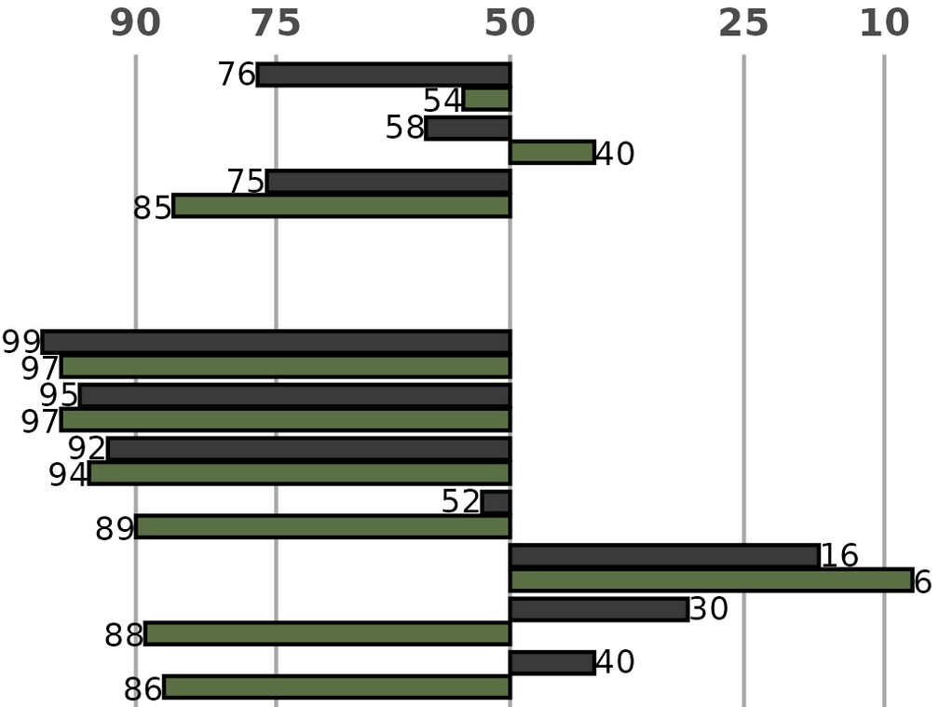
28D PostHaven Farm G2
R e p o r t 2 0 2 5 - 2 0 2 6 B u l l E v a l u a t i o n
4
B A S I C I N F O R M A T I O N
Tattoo | PEJ 59N | Breed | Limousin
Birthdate | 14-Apr-2025 | Reg ID | CFM4129358
Colour |  | Horns | NA
Born As | Single | Calving Ease | Unassisted
O V E R A L L G E N E T I C M E R I T
BIO$ | Maternal
 | Terminal
 | Balanced
POSTHAVEN NICHOLAS
P E D I G R E E
1977881
CFSV POLLED NEWSTAR 703X
NFM2118594
SVL MR. ACHIEVEMENT 402D
S I R E
2056869
GTMO BALFOUR 08B
D A M NFF2323384
SVL JULIANNE 801H
1902392
CCRA TABOO 08T
NFF2099966
ROCKIN' R JASMINE 13E
EPD | ABC | E P D | A B C | A C C
 |  | -2 | 2 | 17
 |  | 0.4 | -2.2 | 47
 |  | -3 | 31 | 31
 |  | -9 10 6 -13 3 PE -15 34 PE -0.04 -0.48 PE 0.22 0.68 PE 0.04 -0.07 PE 0.15 -0.44 PE
st Updated: | 16-Feb-2026 | I N F E R I O R S U P E R I O R
G E N E T I C E V A L U A T I O N S
 | Calving Ease (%) Birthweight (lb) Weaning Gain (lb) Maternal Calving Ease (%) Maternal Birthweight (lb) Milk (lb) Post-Weaning Gain (lb) Yearling Gain (lb) Back Fat (mm) Rib Eye Area (in² ) Marbling (%) Scrotal Circumference (cm)
P E R C E N T I L E R A N K I N G S ( % )
P E R F O R M A N C E
Stage | Weight (lb) | ADG (lb) |  | Ultrasound
Birth | 85 |  |  | Back Fat (mm)
Weaning | 642 | 2.56 |  | Rib Eye Area (in²)
Adj WWT | 597 | 2.56 |  | Adj Rib Eye Area (in²)
SOT | 821 |  |  | Marbling (%)
28D | 886 | 2.32 |  | Adj Marbling (%)
Adj YWT |  |  |  | Grade
Physical Evaluation
Weight / Day of Age (lb)
Hip Height (in)
Frame Actual SC (cm) Adj 365d SC (cm)
Breeding Soundness
C O N T A C T
Consignor Comments
Contact
E. JOHN POST
POSTHAVEN FARM
519-846-9320 / ejpost@posthavenlimousin.com

Slide 11
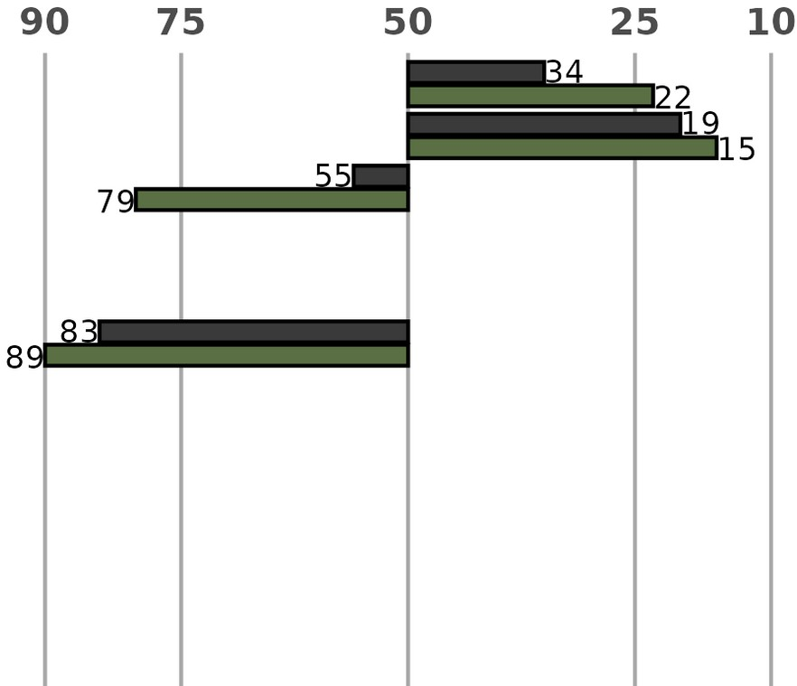
28D PostHaven Farm G2
R e p o r t 2 0 2 5 - 2 0 2 6 B u l l E v a l u a t i o n
5
B A S I C I N F O R M A T I O N
Tattoo | PEJ 61N | Breed | Limousin
Birthdate | 30-Apr-2025 | Reg ID | CPM4129360
Colour |  | Horns | NA
Born As | Single | Calving Ease | Unassisted
O V E R A L L G E N E T I C M E R I T
BIO$ | Maternal
 | Terminal
 | Balanced
POSTHAVEN NEUTRON
P E D I G R E E
CPM4089888
JYF EDMONTON 519E
S I R E CPM4118017
BLCC K544 HIAWATHA
D A M NPF2481234
BCVF JOY BELLE 930J ET
EPD
ABC
E P D A B C A C C
1 4 15
-1.9 -4.4 45
0 34 31
G E N E T I C E V A L U A T I O N S
 | Calving Ease (%)
 | Birthweight (lb) Weaning Gain (lb) Maternal Calving Ease (%) Maternal Birthweight (lb) Milk (lb) Post-Weaning Gain (lb) Yearling Gain (lb) Back Fat (mm) Rib Eye Area (in² ) Marbling (%) Scrotal Circumference (cm)
-3
16
6
Last Updated:
16-Feb-2026
I N F E R I O R
S U P E R I O R
P E R C E N T I L E R A N K I N G S ( % )
P E R F O R M A N C E
Stage | Weight (lb) | ADG (lb) |  | Ultrasound
Birth | 79 |  |  | Back Fat (mm)
Weaning | 615 | 2.65 |  | Rib Eye Area (in²)
Adj WWT | 623 | 2.71 |  | Adj Rib Eye Area (in²)
SOT | 815 |  |  | Marbling (%)
28D | 896 | 2.89 |  | Adj Marbling (%)
Adj YWT |  |  |  | Grade
Physical Evaluation
Weight / Day of Age (lb)
Hip Height (in)
Frame Actual SC (cm) Adj 365d SC (cm)
Breeding Soundness
C O N T A C T
Consignor Comments
Contact
E. JOHN POST
POSTHAVEN FARM
519-846-9320 / ejpost@posthavenlimousin.com

Slide 12

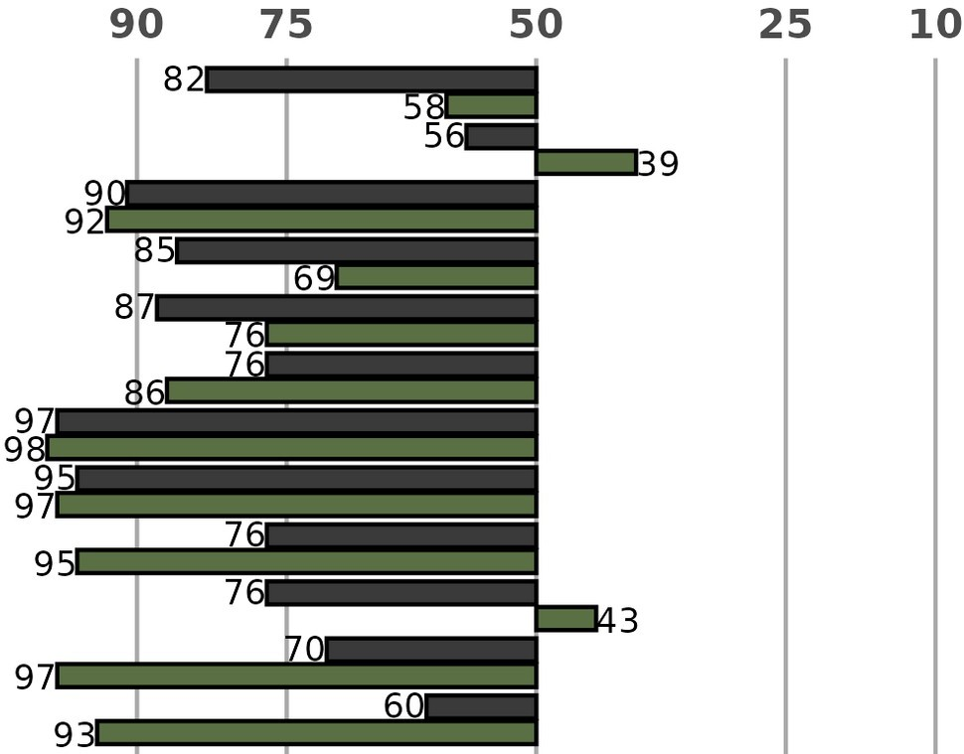
28D PostHaven Farm G2
R e p o r t 2 0 2 5 - 2 0 2 6 B u l l E v a l u a t i o n
6
B A S I C I N F O R M A T I O N
Tattoo | PEJ 217N | Breed | Limousin
Birthdate | 04-May-2025 | Reg ID | CFM4129361
Colour |  | Horns | NA
Born As | Single | Calving Ease | Unassisted
O V E R A L L G E N E T I C M E R I T
BIO$ | Maternal
 | Terminal
 | Balanced
POSTHAVEN NORTH-STAR
P E D I G R E E
NFM1932399
CF JIM DANDIE 216U
AUSLM22106 2721390
ELITE LACETTE ET
S I R E
4120677
IRVINEDALE POLL LUKE
D A M CFF4107687
POSTHAVEN HOPE
4105587
IRVINEDALE POLL HARMONY
CFF0215484
POSTHAVEN P AUTUMN
 | EPD | ABC |  |  | E P D | A B C | A C C
 |  |  |  |  | -2 | 1 | 20
 |  |  |  |  | 0.2 | -2.3 | 49
 |  |  |  |  | -8 | 26 | 34
 |  |  |  |  | -2 | 2 | PE
 |  |  |  |  | -0.6 | -1 | PE
 |  |  |  |  | -2 | 17 | 9
 |  |  |  |  | -15 | 0 | PE
 |  |  |  |  | -22 | 27 | PE
 |  |  |  |  | -0.22 | -0.65 | PE
 |  |  |  |  | -0.19 | 0.27 | PE
 |  |  |  |  | -0.03 | -0.14 | PE
 |  |  |  |  | -0.14 | -0.73 | PE
 |  |  | I N F E R I O R | S U P E R I O R
G E N E T I C E V A L U A T I O N S
 | Calving Ease (%)
 | Birthweight (lb) Weaning Gain (lb) Maternal Calving Ease (%) Maternal Birthweight (lb) Milk (lb) Post-Weaning Gain (lb) Yearling Gain (lb) Back Fat (mm) Rib Eye Area (in² ) Marbling (%) Scrotal Circumference (cm)
Last Updated:
16-Feb-2026
P E R C E N T I L E R A N K I N G S ( % )
P E R F O R M A N C E
Stage | Weight (lb) | ADG (lb) |  | Ultrasound
Birth | 84 |  |  | Back Fat (mm)
Weaning | 610 | 2.66 |  | Rib Eye Area (in²)
Adj WWT | 616 | 2.66 |  | Adj Rib Eye Area (in²)
SOT | 800 |  |  | Marbling (%)
28D | 874 | 2.64 |  | Adj Marbling (%)
Adj YWT |  |  |  | Grade
Physical Evaluation
Weight / Day of Age (lb)
Hip Height (in)
Frame Actual SC (cm) Adj 365d SC (cm)
Breeding Soundness
C O N T A C T
Consignor Comments
Contact
E. JOHN POST
POSTHAVEN FARM
519-846-9320 / ejpost@posthavenlimousin.com

Slide 13

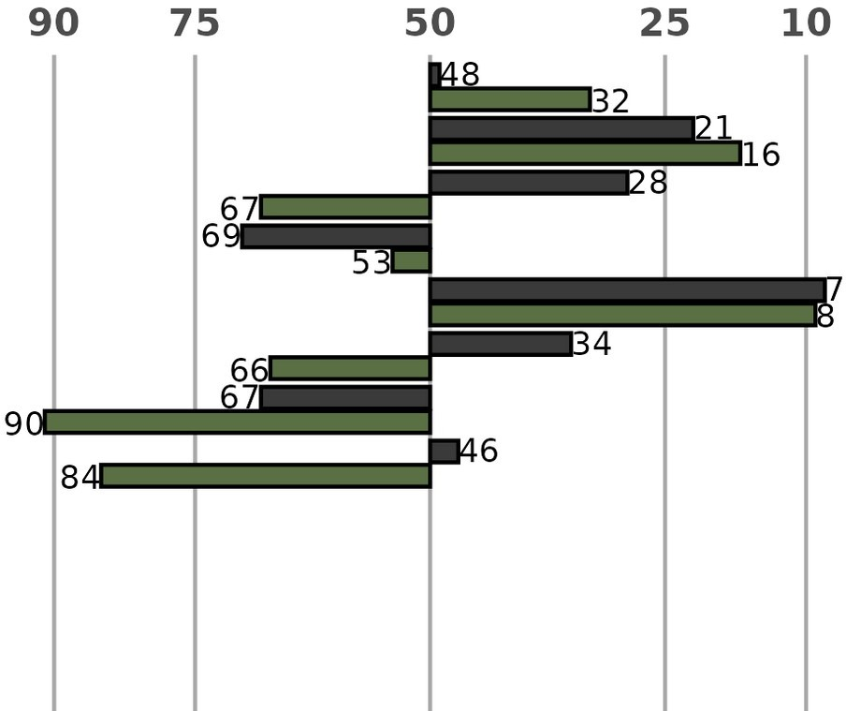
28D PostHaven Farm G2
R e p o r t 2 0 2 5 - 2 0 2 6 B u l l E v a l u a t i o n
7
B A S I C I N F O R M A T I O N
Tattoo | PEJ 2N | Breed | Limousin
Birthdate | 12-May-2025 | Reg ID | CPM4129364
Colour |  | Horns | NA
Born As | Single | Calving Ease | Unassisted
O V E R A L L G E N E T I C M E R I T
BIO$ | Maternal
 | Terminal
 | Balanced
POSTHAVEN NEXUS
P E D I G R E E
CIM0000964
HARVEST OLYMPUS
S I R E CPM4118017
BLCC K544 HIAWATHA
D A M 4099500
DENISON GOLDEN STATE
CFF0184936
DENISON POLL TIZA YUKON
EPD
ABC
E P D A B C A C C
0 3 20
-1.7 -4.2 50
4 38 36
0 4 PE
1.3 0.9 PE
3 22 10
-2 13 PE
3 52 PE
G E N E T I C E V A L U A T I O N S
 | Calving Ease (%)
 | Birthweight (lb) Weaning Gain (lb) Maternal Calving Ease (%) Maternal Birthweight (lb) Milk (lb) Post-Weaning Gain (lb) Yearling Gain (lb) Back Fat (mm) Rib Eye Area (in² ) Marbling (%) Scrotal Circumference (cm)
Last Updated:
16-Feb-2026
I N F E R I O R
S U P E R I O R
P E R C E N T I L E R A N K I N G S ( % )
P E R F O R M A N C E
Stage | Weight (lb) | ADG (lb) |  | Ultrasound
Birth | 88 |  |  | Back Fat (mm)
Weaning | 666 | 3.04 |  | Rib Eye Area (in²)
Adj WWT | 696 | 3.04 |  | Adj Rib Eye Area (in²)
SOT | 862 |  |  | Marbling (%)
28D | 946 | 3.00 |  | Adj Marbling (%)
Adj YWT |  |  |  | Grade
Physical Evaluation
Weight / Day of Age (lb)
Hip Height (in)
Frame Actual SC (cm) Adj 365d SC (cm)
Breeding Soundness
C O N T A C T
Consignor Comments
Contact
E. JOHN POST
POSTHAVEN FARM
519-846-9320 / ejpost@posthavenlimousin.com

Slide 14
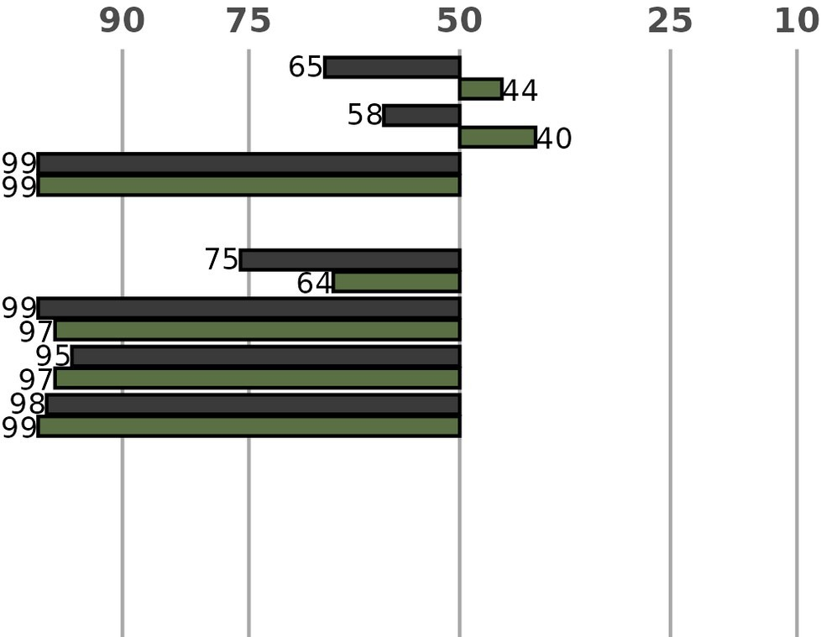
28D PostHaven Farm G2
R e p o r t 2 0 2 5 - 2 0 2 6 B u l l E v a l u a t i o n
8
B A S I C I N F O R M A T I O N
Tattoo | PEJ 218N | Breed | Limousin
Birthdate | 19-May-2025 | Reg ID | CFM4129362
Colour |  | Horns | NA
Born As | Single | Calving Ease | Unassisted
O V E R A L L G E N E T I C M E R I T
BIO$ | Maternal
 | Terminal
 | Balanced
POSTHAVEN NEOPHIN
P E D I G R E E
CFM0209827
POSTHAVEN P ZANSIBAR
S I R E NFM2564470
GAAN DAKOTA RG 8L
D A M
POSTHAVEN GLAMOROUS
CFF0221106
CEDAR PATCH PP LAGUNA
EPD
ABC
E P D A B C A C C
-1 2 17
0.3 -2.2 47
-18 16 33
G E N E T I C E V A L U A T I O N S
 | Calving Ease (%)
 | Birthweight (lb) Weaning Gain (lb) Maternal Calving Ease (%) Maternal Birthweight (lb) Milk (lb) Post-Weaning Gain (lb) Yearling Gain (lb) Back Fat (mm) Rib Eye Area (in² ) Marbling (%) Scrotal Circumference (cm)
-0.3
-8
-13
-31
-0.7
10
2
18
PE 7 PE PE
Last Updated:
16-Feb-2026
I N F E R I O R
S U P E R I O R
P E R C E N T I L E R A N K I N G S ( % )
P E R F O R M A N C E
Stage | Weight (lb) | ADG (lb) |  | Ultrasound
Birth | 85 |  |  | Back Fat (mm)
Weaning | 500 | 2.27 |  | Rib Eye Area (in²)
Adj WWT | 539 | 2.27 |  | Adj Rib Eye Area (in²)
SOT | 665 |  |  | Marbling (%)
28D | 720 | 1.96 |  | Adj Marbling (%)
Adj YWT |  |  |  | Grade
Physical Evaluation
Weight / Day of Age (lb)
Hip Height (in)
Frame Actual SC (cm) Adj 365d SC (cm)
Breeding Soundness
C O N T A C T
Consignor Comments
Contact
E. JOHN POST
POSTHAVEN FARM
519-846-9320 / ejpost@posthavenlimousin.com

